Slide 1







English Lesson Module 1
THE SCHOOL
Let's learn and have fun!

Slide 2







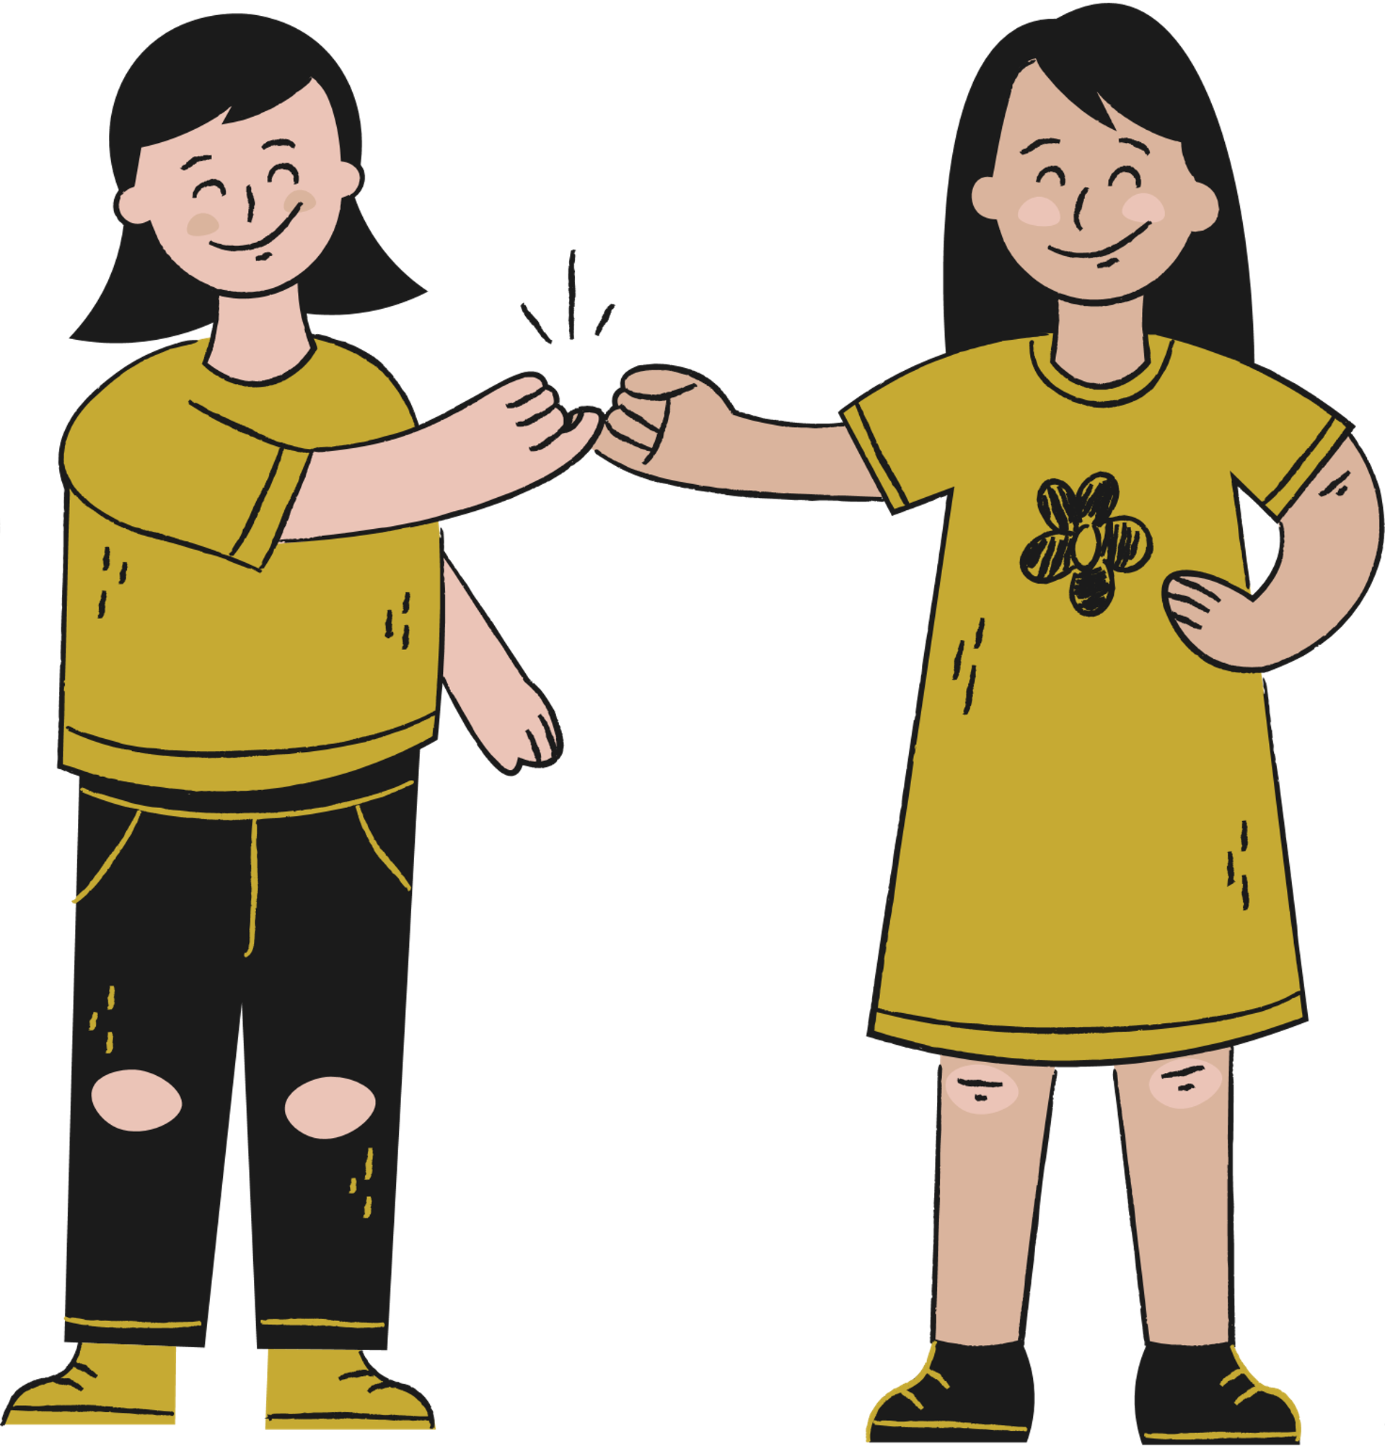


Hello, class!
By the end of the lesson, pupils will be able to:
Lesson
Objectives
Understand with support, the main idea of very simple phrases and sentences.
Name or describe objects using suitable words from word sets.

Slide 3
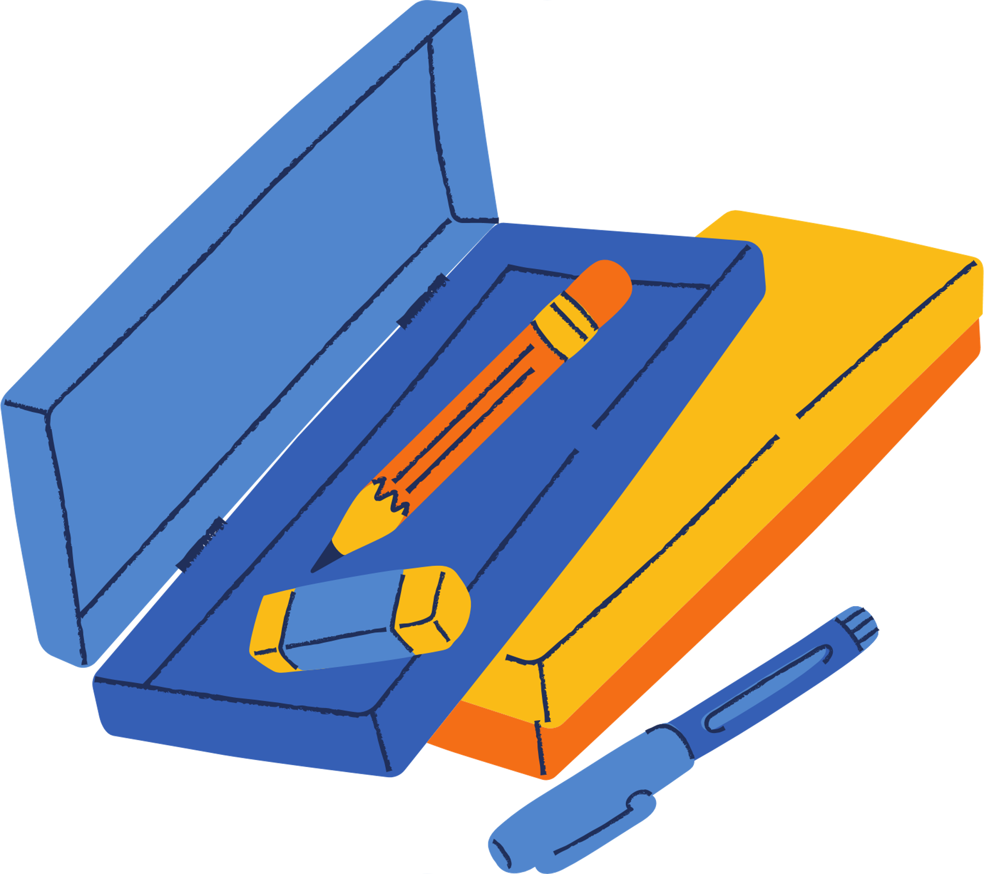







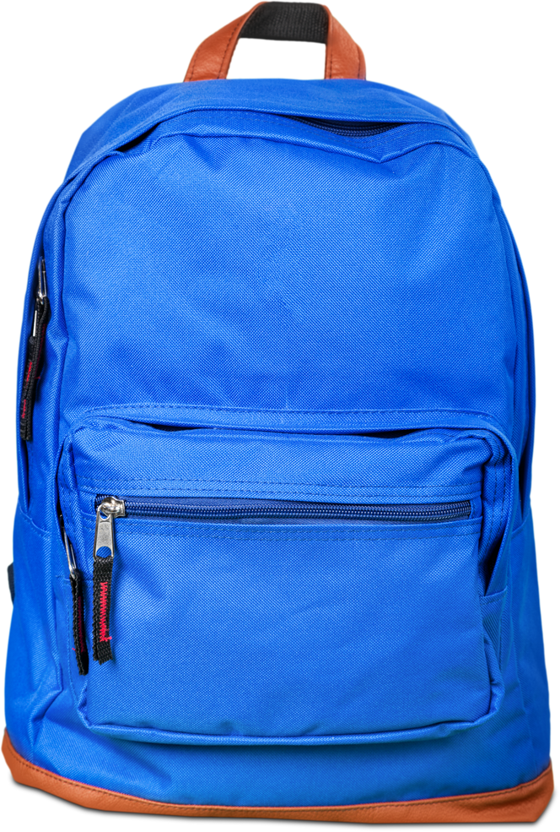
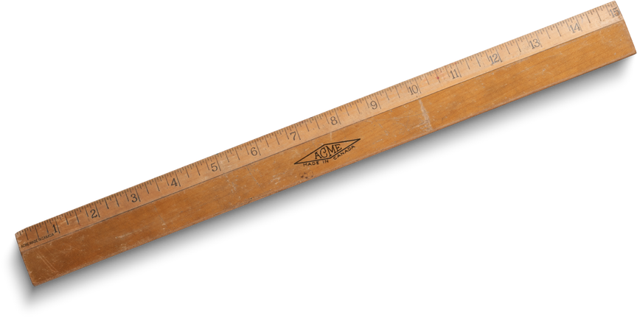


WHAT ARE THE THINGS WE CAN FIND IN SCHOOL ?
PENCIL
PEN
PENCIL CASE
NOTEBOOK
ERASER
BOOK
RULER
BAG
DESK

Slide 4






LET'S TEST YOUR KNOWLEDGE
What's this?
This is a _______
What's this?
This is a _______

Slide 5



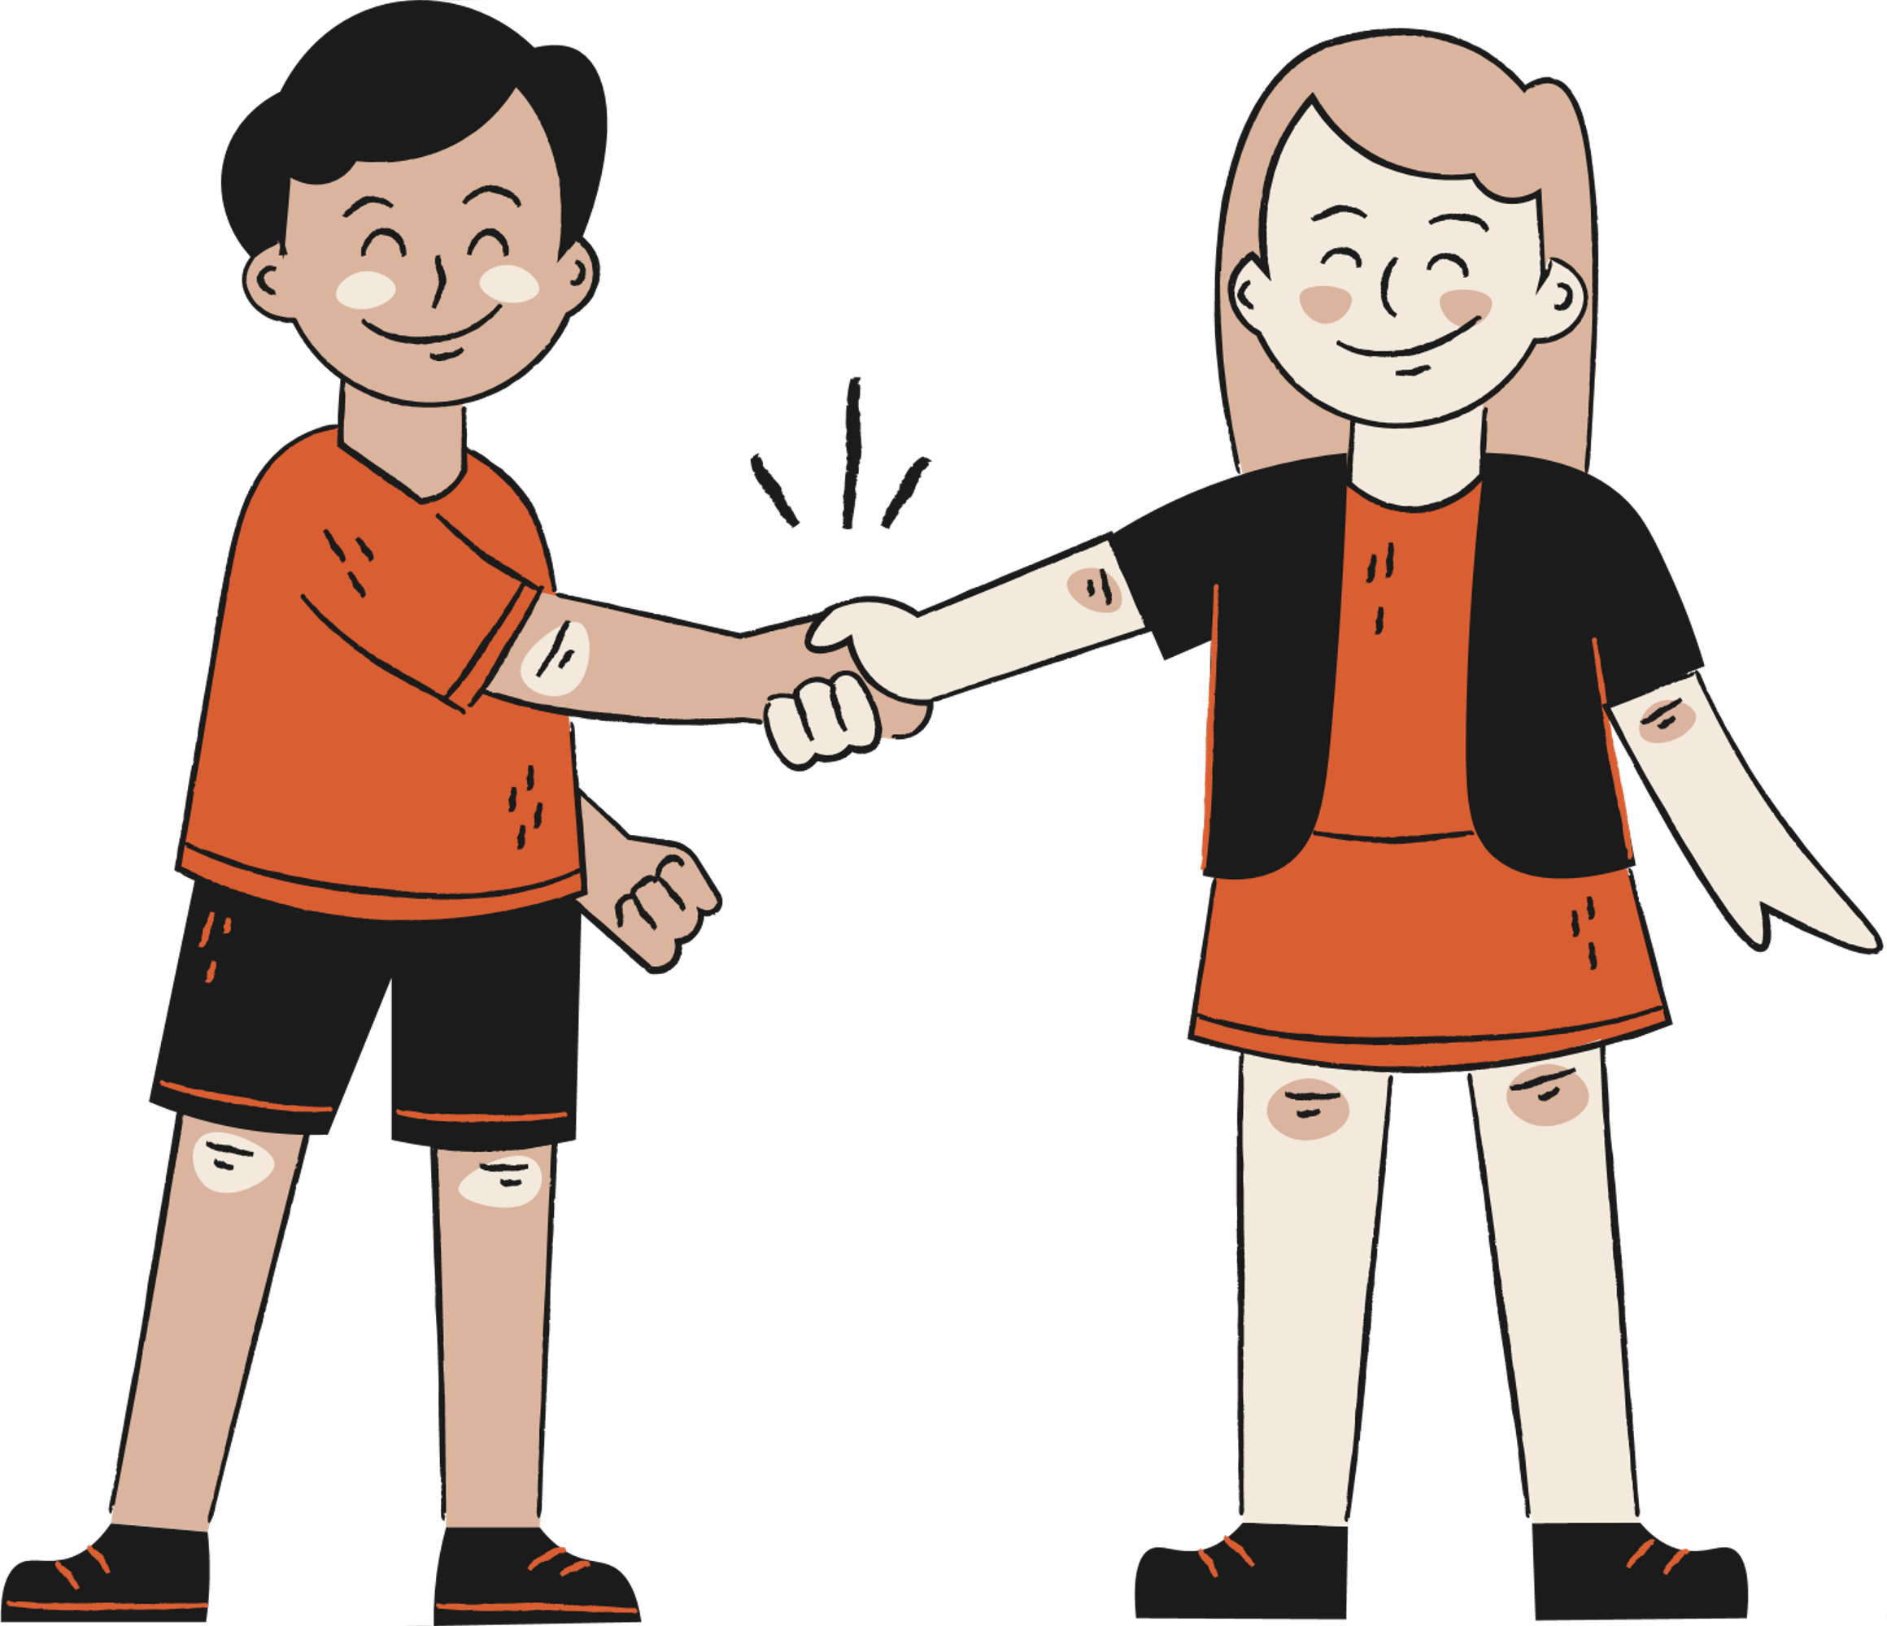
What did we learn today?

Slide 6




Thank you, class!
Join in another class and
let's have fun again together!

